Slide 1
Health and Wellness 101
Understanding Your health

Slide 2
What is Health?
“The state of being free from illness or injury”
“A person’s mental or physical condition”
As defined by the World Health Organization (WHO), health is a “state of complete physical, mental, and social well being, and not merely the absence of disease or infirmity.”
Health is a dynamic condition resulting from a body’s constant adjustment and adaptation in response to changes in the environment for maintaining an inner equilibrium called homeostasis.

Slide 3
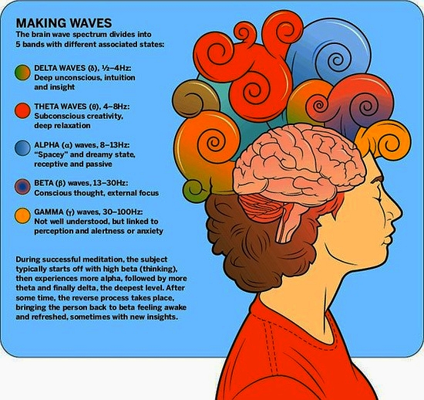
What does being healthy really mean?
The word “healthy” means different things to different people. It could mean one thing to a college student and then something different to an older adult.
No matter who you are, being healthy does not have one definition or set of rules you have to live by - and it starts with a positive mindset!
Being healthy doesn’t mean following a strict diet or exercise regime, it means finding out what works best for you and your lifestyle and making choices that can help energize you, treat your body with care and respect, and fuel you with the right nutrients.

Slide 4
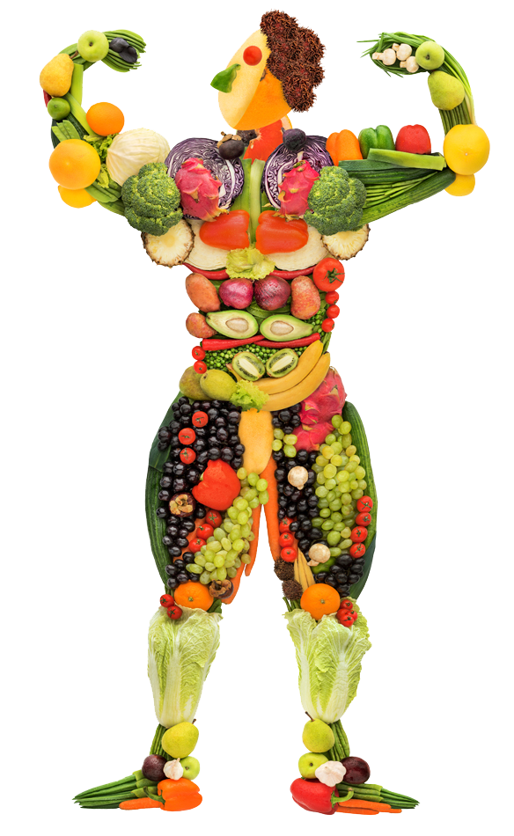
A healthy lifestyle looks different on every body
We all have different things going on in our lives, so it’s important to make choices that help you to live a positive life, rather than cause you any stress or discomfort in trying to live a certain way.

Slide 5
Tips for being healthy in a way that’s best for YOU

Slide 6
Get Active
Being healthy means getting active in some way every day. While it’s important to make exercise part of your life, simply being more active in some way each day is a good place to start if you want to live a healthier lifestyle.
It could be a walk in your yard or the neighborhood, making an effort to walk more places throughout your day, or doing a yoga session – what’s important is not what activity you do but that you are moving your body in some way.

Slide 7
Mindset and Movement
Like nutrition, exercise is impacted by our thoughts, feelings and beliefs. Much research and national rhetoric promotes exercises as a means to reduce one's risk of disease and instead live a longer, healthier life. To that end, one study looked into whether your beliefs about how much you exercise impact longevity. They found that those who perceived themselves as less active were 71% more likely to die in the 21 year follow-up period than their peers, even after they adjusted for the actual amount of physical activity each person performed(Zahrt and Crum, 2017).
Researchers wanted to see if altering this perception would result in changes in health. They assessed a group of hotel maids’ perceived physical activity, which was low, and then explained to them that their workplace activities involved a large amount of physical activity every day. After four weeks, the maids reported higher physical activity levels, though their activity level was the same, and had a decrease in weight, blood pressure, body fat, waist-to-hip ratio and body mass index. This all happened without any changes to their exercise routine, only their beliefs about it ( Crum and Langer, 2017).
These studies suggest that those who perceive themselves to be inactive or not active enough will have worse health outcomes over time, regardless of their actual activity levels. Thankfully, the reverse also appears true. Count all of your steps, your chores and your daily activities as exercise and you may reap better health outcomes over time.

Slide 8
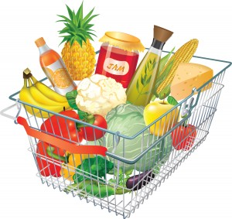
Make food choices that suit you and your budget
The idea of being healthy can often make people think that in order to be healthy, it will cost a lot of money, or that you have to limit yourself of certain foods. This is not an enjoyable or sustainable way to live!
It is possible to eat healthy on a budget! There are tons of delicious meals you can make with simple fresh fruits, veggies, and lean proteins that are easy to get at your grocery store.

Slide 9
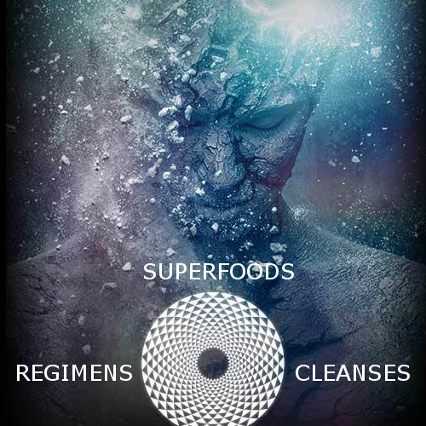
Mindset and Nutrition
You've heard it before: you are what you eat. This statement suggests that if you consume a balanced and nutritious diet you'll fare well, and, conversely, if you eat a diet of highly processed snack foods, you won't. However, more recent research suggests you're not what you eat, you’re what you think you eat.
Researchers at the Stanford mind and body lab conducted a study in which they served participants two milkshakes. One shake, they told participants, was a 140 Calorie “light and sensible shake”. The other shake was described has a 620 calorie “indulgent shake”. Researchers measured the participant’s self-reported level of satiety and intravenous blood levels of ghrelin, which is a hormone that promotes hunger when levels are high and drops as you become full. The catch? Both shakes contained exactly the same number of calories (380, to be exact). Despite this, when participants drank the indulgent shake, they reported higher satiety levels and their blood ghrelin levels produced a dramatically steeper decline than when they drank the sensible shake. Conversely when participants believed they were drinking the sensible shake , their blood ghrelin levels stayed relatively the same. The authors concluded that an individual's beliefs about what he or she is eating dramatically change the body's physiological response to it (Crum et al., 2011)

Slide 10
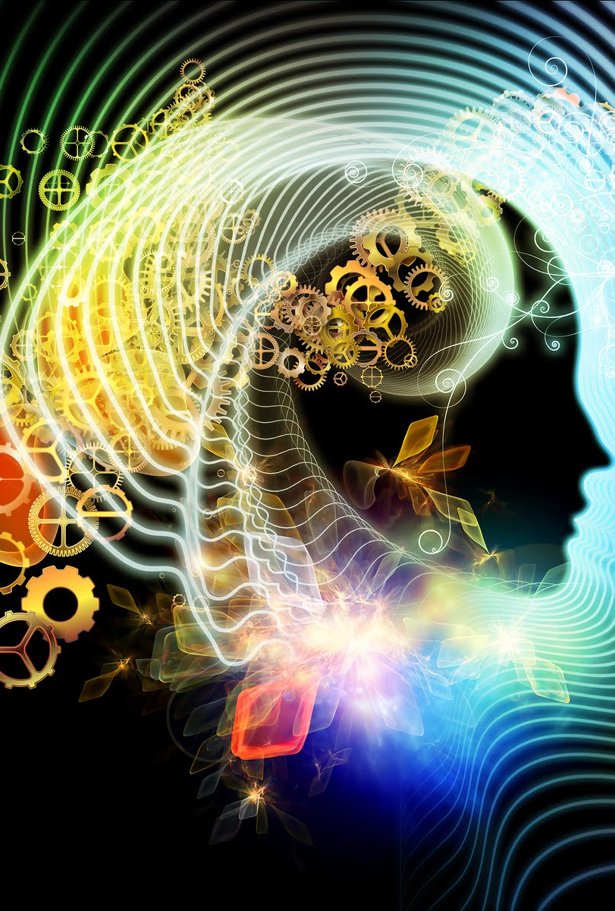
Mindset and Nutrition
This phenomenon is also apparent in a study on vegetable labeling and consumption. After looking at previous research revealing that healthy foods are considered less tasty, filling and satisfying, researchers wanted to see if more vegetables would be consumed if they were given more decadent names . They compared the amount of vegetables consumed when given one of four names : normal, healthy restrictive ,healthy positive or indulgent . Diners chose indulgently labeled vegetables with names like “sweet sizzling green beans” more often than vegetables labeled as normal, healthy positive or healthy restrictive. Healthy restrictive vegetables with labels such as “light and low carb green beans and shallots” were consumed the least, (Turnwald et al., 2017) revealing that our appraisal of food changes its desirability and how much of it we consume.
Another study assessed people with different feelings about chocolate cake, guilt or celebration, and compared perceived eating control and long-term weight maintenance between the two. Participants who associated chocolate cake with guilt did not have healthier eating intentions than those without guilt, but reported lower feelings of self-control around food and were less likely to maintain weight over the following 18 months. (Kuijer and Boyce, 2016).
The results of these studies suggest that mindset matters in the types and amount of foods you choose to consume and your body's physiological response to it. What can you do with this information? Change the way you approach your food. Consider the foods you choose , be there veggies, milkshakes or chocolate cake, as delicious and stressless about their caloric content. Pay attention to the sensations of eating them. You'll be more satisfied and eat healthier when you do.

Slide 11
Learning about food and fitness
Learning is the key to growth, but keep in mind that there are certain situations where too many opinions and articles about the same thing can make things really confusing!
It seems like there are always new diets, but the truth is that quick-fix diets don’t work!
Learn more about wholesome foods and why they are good for you, rather than focusing on diets and restrictions, and you will be able to make informed choices for your body and lifestyle.

Slide 12
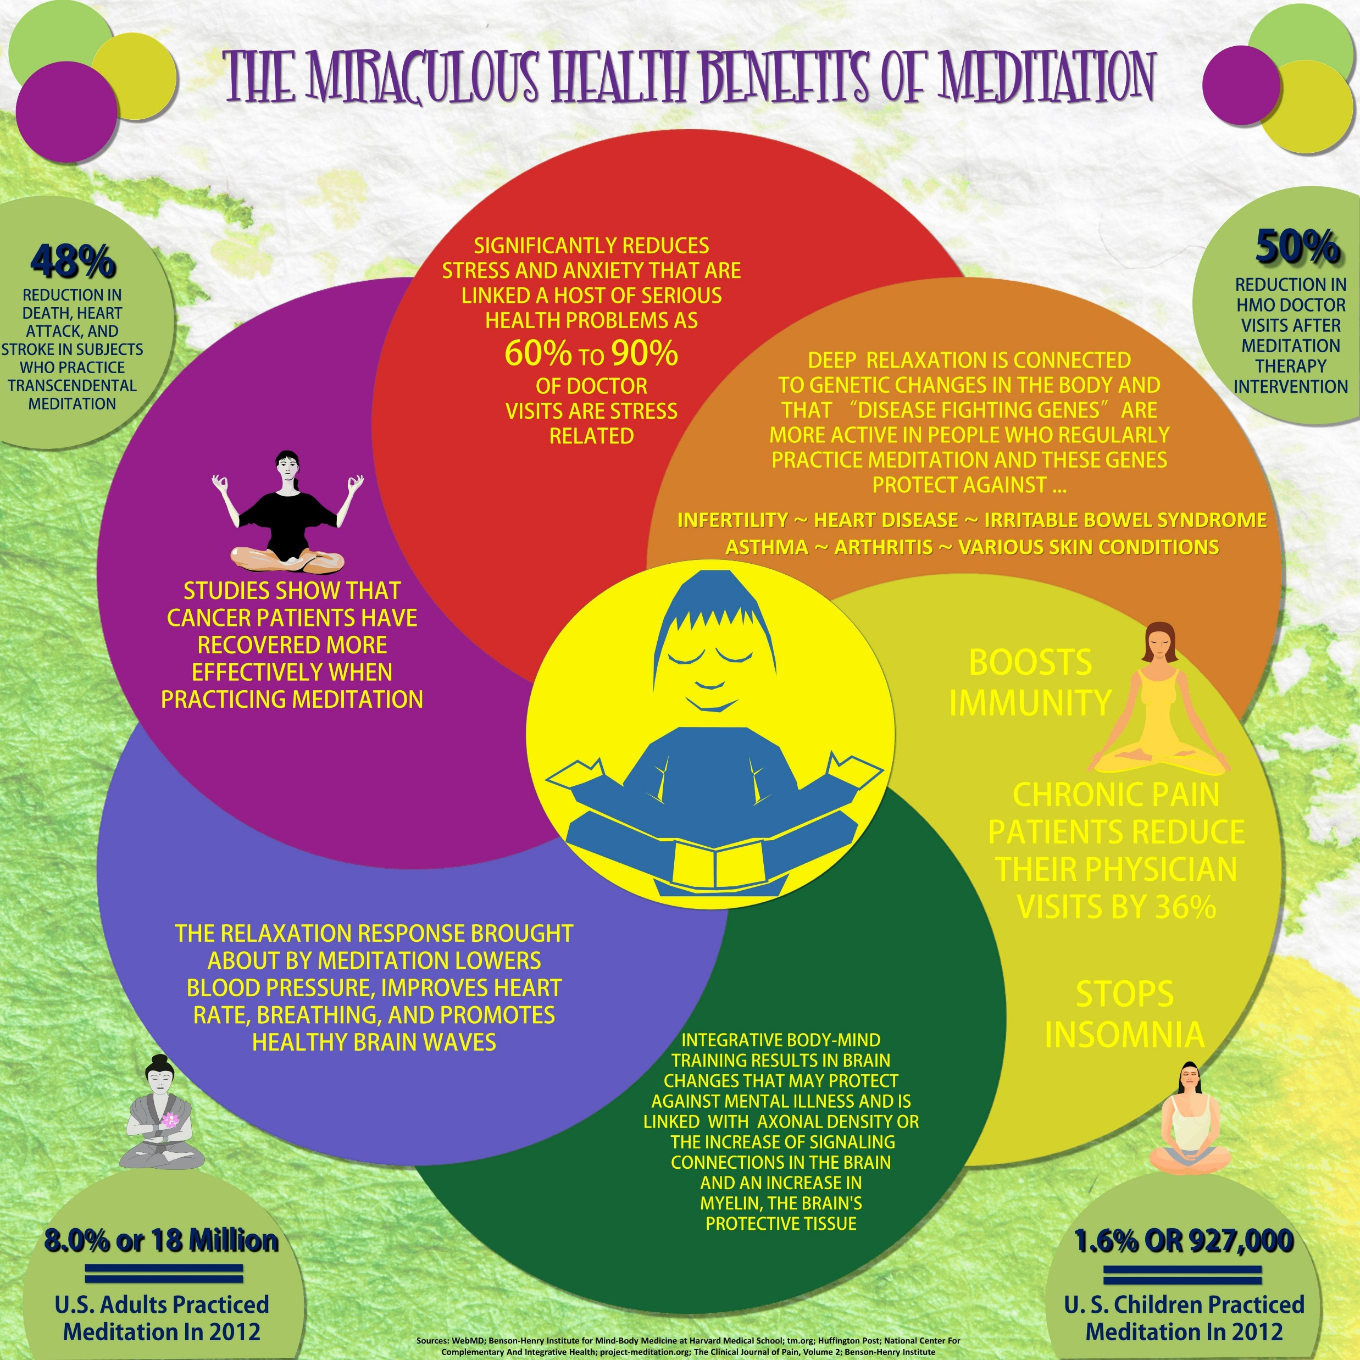
Don’t forget what’s important
Being healthy doesn’t mean you have to spend money each month on clothes, equipment, of memberships!
People use household items like milk jugs, bags of potatoes, or textbooks as weights.
The ultimate goal is how you feel on the inside – not how you look on the outside.
Measure your health by how you feel –are you feeling stronger, fitter, and more energized after regular exercise and eating wholesome foods? Then you are doing great!

Slide 13
Mindset Matters
In an era of increased food and exercise concerns, where the diet du jour constantly changes and many struggle to obtain a sufficient amount of exercise, the studies we talked about offer a helpful proposition: By changing your mindset to become less critical, more inclusive and more positive, you may have the power to improve your health!

Slide 14
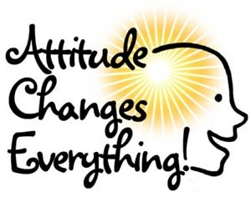
Live a balanced life
The key to a happy and healthy lifestyle is to never deprive yourself and feel like you’re missing out on the things you enjoy. It’s all about balance! If you want to cut refined sugar out of your diet, that’s okay. If that’s not for you, that’s okay too!
It’s about making calculated choices and trying to eat wholesome, nutrient-rich foods as regularly as you can, not depriving yourself of food completely.
Your mindset is the most important thing – and so is your happiness. If you want to achieve something, there is nothing stopping you from pursuing it, apart from YOU!
Believe in yourself and put in effort to develop positive habits every day, even on days you can only manage a small amount!

