Slide 1
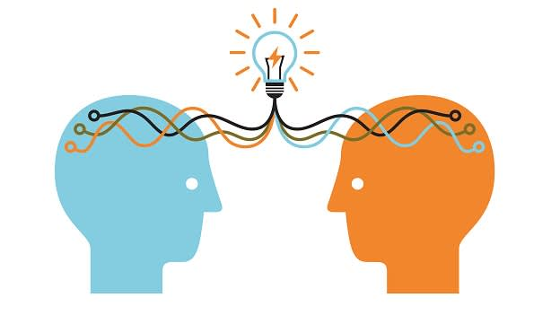
Understanding Your Numbers
Health & Wellness 101

Slide 2
What are your “Numbers”?
Notes:
When you go to the Dr.’s office, the hospital, or have a screening in the community, you might have your blood pressure checked or have some blood taken. The results you get from those kinds of screenings are your health “numbers” and service providers use those results, compared to what is average for most people to see how you are doing. Results outside of what is considered usual for your age group can be an early sign that something is wrong, which is why it is important to know your usual numbers and get regular screenings so that your health providers can help you track them as well.

Slide 3
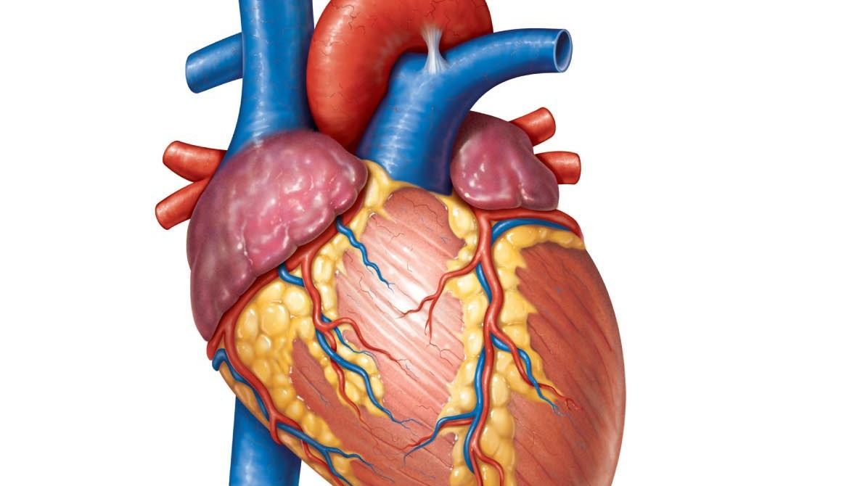
Blood Pressure
Your Healthy Target : Less than 120/80 mm Hg
Notes:
Why it matters: Your blood pressure is the force of your blood pushing against the walls of your arteries. If it’s too high, your heart must work harder. Over time, high blood pressure can cause the heart to enlarge or weaken, which can lead to heart failure. High blood pressure can also narrow your arteries, which disrupts proper blood flow to your heart or brain, triggering a heart attack or stroke.

Slide 4
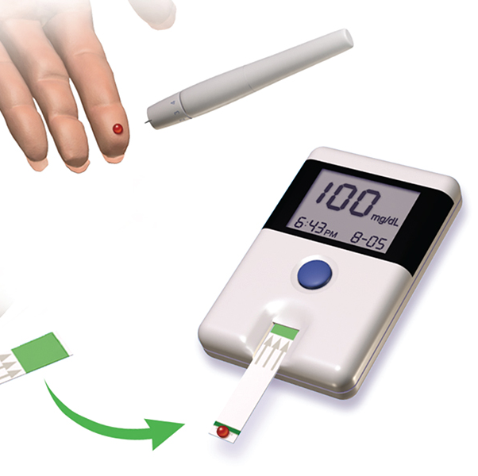
Fasting Blood Glucose
Your Healthy Target: Up to 100 mg/dl
Notes:
Why it Matters: Your body breaks down food into glucose (a type of sugar), which cells absorb for energy. When this process goes awry, glucose builds up in the blood. Extra sugar in your bloodstream is a sign of diabetes, a disease that can harm every organ in your body, while also damaging nerves and blood vessels.

Slide 5
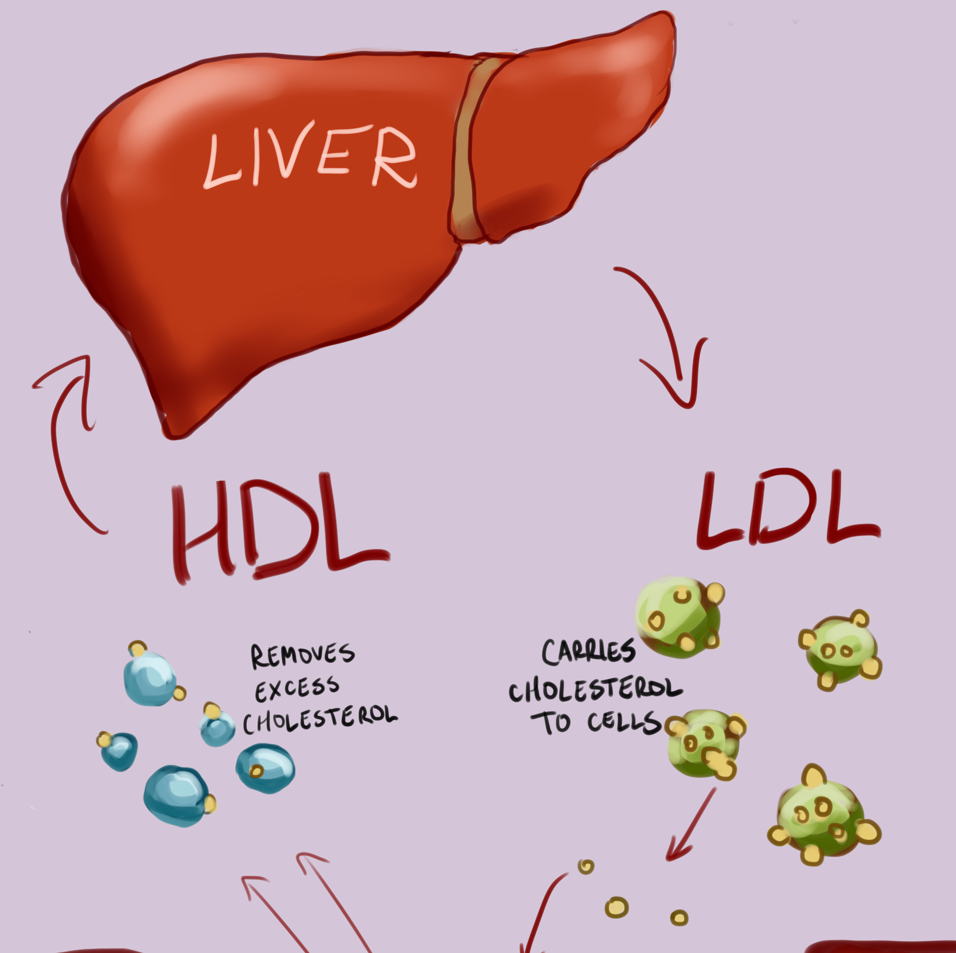
Blood cholesterol
Your Healthy Target total Cholesterol : Less than 200 mg/dL total
Notes:
Why it matters : cholesterol is a fatty substance found in your body cells. It helps your body make important vitamins and hormones. But too much cholesterol can lead to plaque buildup inside your blood vessels. This sticky substance causes your arteries to harden and narrow , which limits blood flow to your heart.

Slide 6
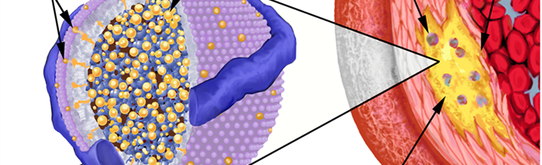
Your Lipoprotein Targets:
LDL: Less than 100 mg/dL
HDL: Men greater than 40 mg/dL and Women greater than 50 mg/dL
Notes:
Why it matters : the body makes all the cholesterol it needs. Cholesterol circulates in the bloodstream but cannot travel by itself. As with oil and water, cholesterol (which is fatty )and blood (which is watery )do not mix. So cholesterol travels in packages called lipow proteins, which have fat (lipid) inside and protein outside. Two main kinds of lipoproteins carry cholesterol in the blood .
low density lipoprotein, or LDL, it's called the bad cholesterol because it carries cholesterol to tissues, including the arteries. Most of the cholesterol in the blood is the LDL form. The higher the level of LDL cholesterol in the blood, the greater your risk for heart disease.
High density lipoprotein, or HDL, it's called the good cholesterol because it takes cholesterol from tissues to the liver, which removes it from the body. A low level of HDL cholesterol increases your risk for heart disease.

Slide 7
Triglycerides
Your Healthy Target: Less than 150 mg/dL
Notes:
Why it matters : triglycerides, which are produced in the liver, are another type of fat found in the blood and in food. Causes of raise triglycerides are overweight / obesity , physical inactivity , cigarette smoking, excess alcohol intake, and a diet very high in carbohydrates (60% of calories or higher ). A triglyceride level of 150 mg/dL or higher also is one of the risk factors of the metabolic syndrome .

Slide 8
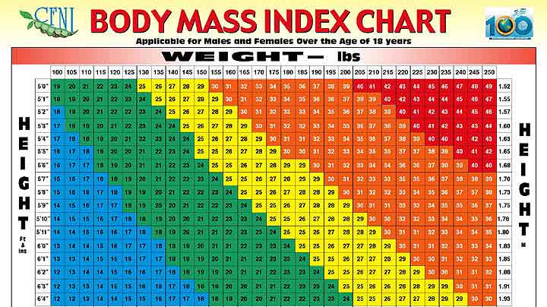
Body Mass Index
Your Healthy Target: 18.5 -24.9
Notes:
Why it matters: Your BMI Is a weight height calculation that can help determine if you're overweight or obese. Excess body fat increases your risk for a wide range of health problems, including high blood pressure, heart disease, type 2 diabetes and sleep apnea . BMI is not always an accurate way to determine whether you need to lose weight here are some exceptions.
Bodybuilders. Because muscle weighs more than fat, people who are unusually muscular may have a high BMI .
elderly. In the elderly it is often better to have a BMI between 25 and 27, rather than under 25. If you are older than 65, for example, a slightly higher BMI may help protect you from osteoporosis .
children. While an alarming number of children are obese, do not use a BMI calculator for evaluating a child. Talk to a pediatrician about the appropriate weight for your child age.

Slide 9
Positive Lifestyle Choices
Notes:
Whether you need to lower your blood pressure, cholesterol, glucose, or BMI, positive lifestyle choices often lead to a healthier you. More importantly, you feel energized. Let's talk about some ways to initiate positive lifestyle choices .

Slide 10
Notes:
Sufficient sleep is increasingly being recognized as an essential aspect of chronic disease prevention and health promotion. Sleep needs vary from person to person and change as people age. 7 to 9 hours per night is recommended for adults .

Slide 11
Connect
Notes:
Social support, whether from a trusted group or valued individual, has been shown to reduce the psychological and physiological consequences of stress, and may enhance immune function. Social networks whether formal (such as a religious organization or social club ) or informal (meeting with friends ) provide a sense of belonging, security, and community. With any social support network, make sure you feel comfortable with the group's beliefs, practices, and expectations. While it's unrealistic to think you'll never experience any disagreement with your friends, family it, or other social support network, remember that spending time with them should make you feel accepted, peaceful, and energized, not coerced or anxious.

Slide 12
Exercise
Notes:
Aim for 30 minutes of moderate activity such as walking, jogging, swimming, biking, or dancing five days per week. Start slowly and listen to your body. Strive to incorporate gentle stretching and balance exercises daily and strength training two to three times per week.

Slide 13
Notes:
Eat a heart healthy diet. Fill your plate with plenty of fruits and vegetables, lean proteins, whole grains, and low fat dairy products .

Slide 14
Quit Smoking & Limit Alcohol
Notes:
If you drink alcohol, do so moderately. That means no more than one drink daily for women and no more than two drinks daily for men.

Slide 15
Relax
Notes:
Using relaxation or mindfulness techniques (such as breathing techniques, imagery, and centering )throughout your day counteracts the effects of long term stress, which may contribute to or worsen a range of health problems including depression, digestive disorders, headaches, high blood pressure, and insomnia.

Slide 16
Share your numbers with your doctor
Notes:
Share your numbers with your doctor. Discuss if medication or medication adjustment is appropriate for you

Slide 17
Maintaining a healthy lifestyle
Notes:
Maintaining a healthy lifestyle can minimize the risk of developing a number of chronic diseases in the future. More importantly you feel good and are better prepared to meet the joys and challenges of life.

